Slide 1
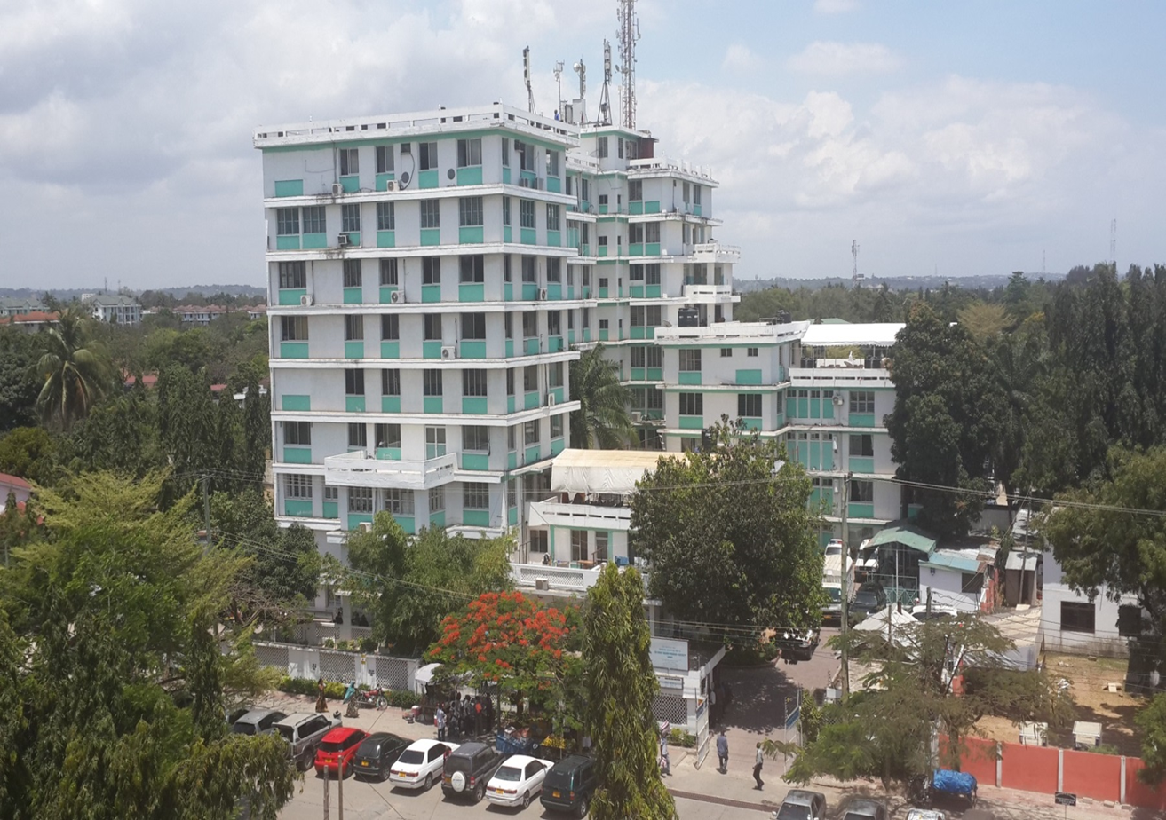
BRIDGE PROJECT KICK-OFF-MEETING
KAIRUKI UNIVERSITY,
DAR ES SALAAM
Date: 18.03.2026
KU Representatives
Prof. Yohana Mashalla
Prof. Columba Mbekenga
Dr. Tausi Haruna
Mr. Kaizilege Karoma
Ms. Nuru Kanju

Slide 2
Kairuki University: Introduction
Established in 1997 under Kairuki Health and Education Network (KHEN) umbrella
Accredited by Tanzania Commission for Universities (TCU)
Core functions:
Teaching,
Research and
Consultancy services

Slide 3
KU Academic Programs
Undergraduate
Doctor of Medicine (MD)
Bachelor of Science in Nursing (BscN)
Bachelor of Social Work (BSW)
Diploma in Nursing
Diploma in Social Work
Postgraduate
Master of Medicine (M.Med):
Internal Medicine; Pediatrics & Child Health; General Surgery; Obstetrics and Gynecology
Master of Science in Public Health (MscPH)
Master of Social Work (MSW)

Slide 4
Research activities
Under the Directorate of Postgraduate Studies and Research Institute
Headed by Prof. Columba Mbekenga, the current Director
The Directorate is responsible for:
Providing high quality postgraduate training
Carrying out relevant research
Strategic direction in offering professional services to meet challenging society needs
Enhancing research engagement and training in research methods

Slide 5
University Five Year Rolling Strategic Plan
Has six strategic objectives including:
1.Governance
2. Human resources management and development
3. Inclusive teaching and learning
4. Infrastructure development
5. Research, consultancy and innovation
6. Finance, planning, procurement and audit

Slide 6
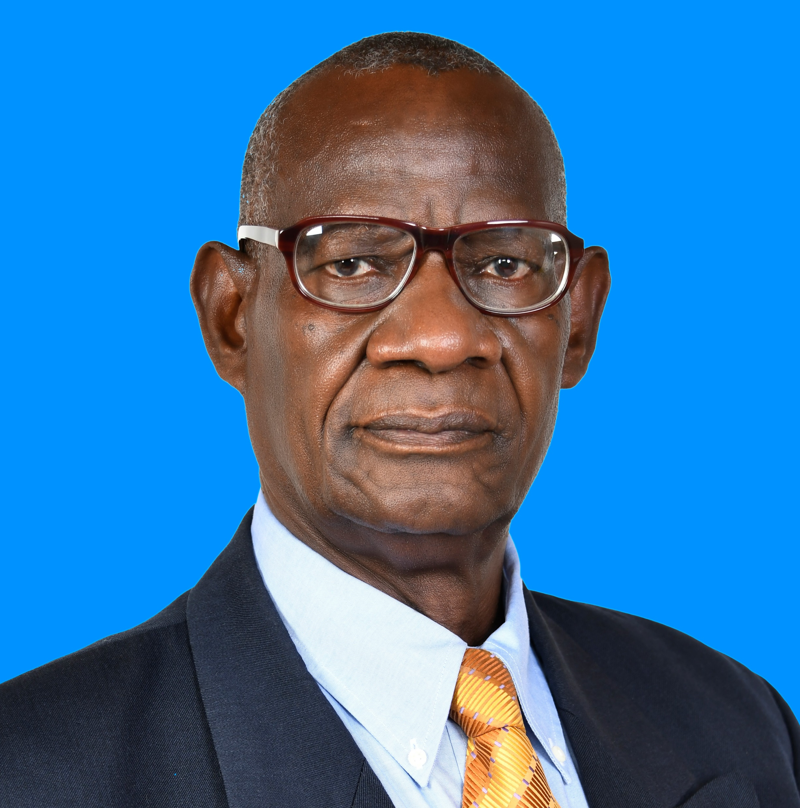
Expertise & Human Resources-BRIDGE Project
Prof. Yohana Mashalla, (MD, PhD)
Has experience in basic and applied research
Has published extensively in his area of specialization
Has experience in training undergraduate and postgraduate students
Experienced researcher in global health & grant writing
Secured research funds from external sources
Experienced in managing external funds
Will bring experience in training, research management & strategic leadership
Current VC

Slide 7
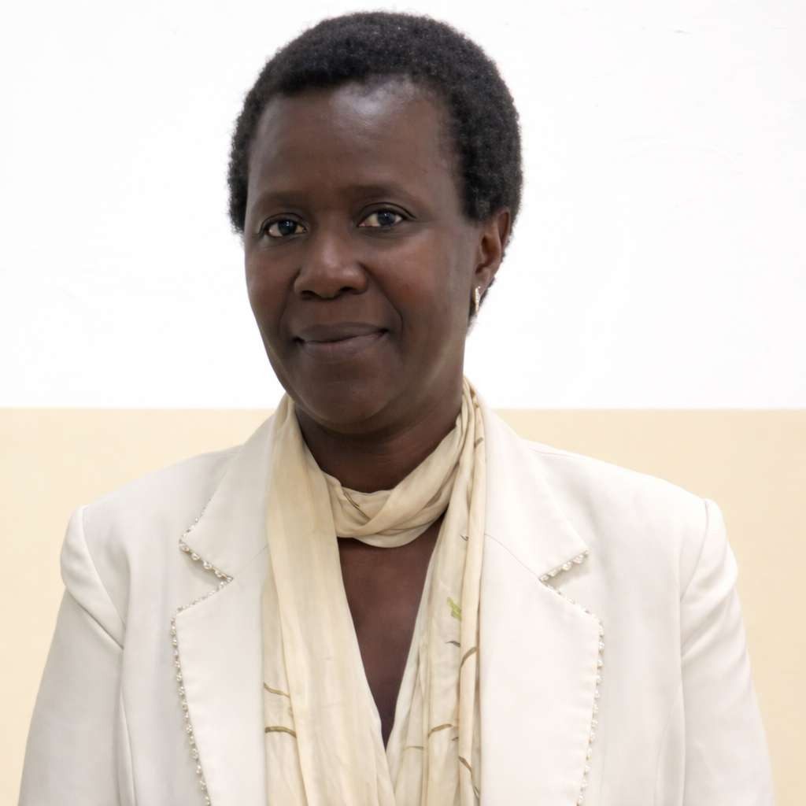
Expertise & Human Resources -BRIDGE Project
Prof. Columba Mbekenga (PhD, MSc PH,BScN)
Associate Professor in the Faculty of Nursing: Dept of RCH
Over 20 years of teaching experience in higher-learning institutions, both in public and private universities.
Active researcher with strong expertise in Qualitative research methodologies
Has participated in numerous North-South and South-South collaborative research initiatives and postgraduate supervision programs
KU LEAR for the BRIDGE project
Her work has involved designing, implementing, and coordinating research projects and capacity-building courses aimed at addressing health challenges in low-income settings
Current Director for PGSRI

Slide 8
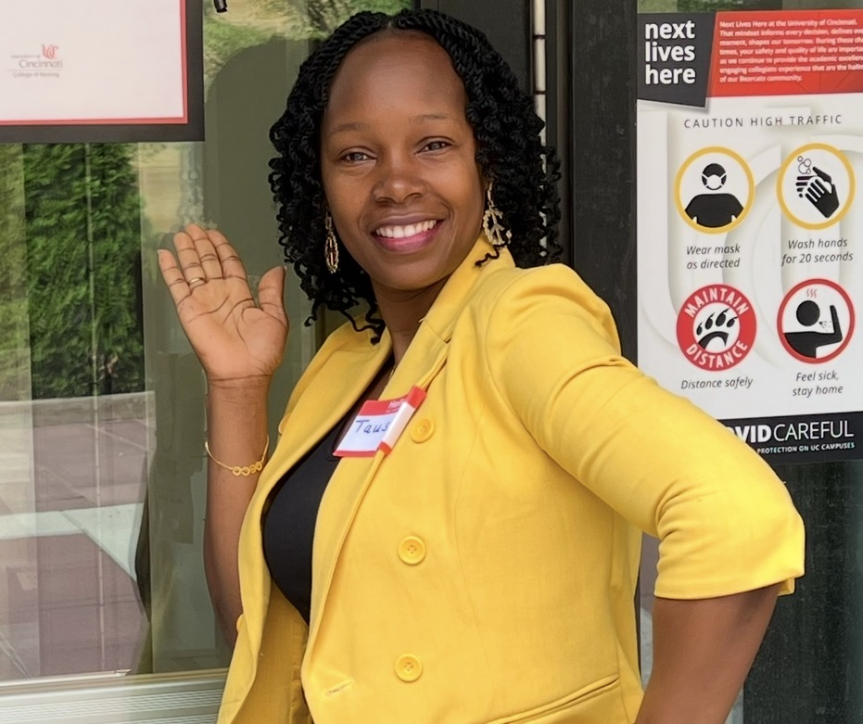
Expertise & Human Resources -BRIDGE Project
Dr. Tausi S. Haruna (PhD, MB, RN)
Registered Nurse, Bioethicist & Lecturer at KU with over 15 years of dedicated service
Experienced in teaching undergraduate and post-graduate students
Has a strong foundation in academic mentorship, clinical excellence, research supervision, and ethical leadership in healthcare
She earned her PhD in Nursing Research from the University of Cincinnati in Ohio, USA
Her Doctoral work contributes to evidence-based, rights-informed maternal health policy and advances scholarship at the intersection of nursing science, bioethics, and global maternal health.
Dr. Haruna is also a fellow of the Afya Bora Consortium Fellowship in Global Health Leadership
Dr. Haruna is also a fellow of the Afya Bora Consortium Fellowship in Global Health Leadership
Potential trainer for the `~IDGE/

Slide 9

Infrastructure
The IT Department is headed by Mr. Kaizilege Karoma
He holds a Bachelor in Business Information Technology
The department is responsible for ensuring a sustainable internet infrastructure, training staff and students on the use of technology
The university has a bandwidth capacity of 400 Mbps used for all university operations in addition to Eduroam
The department assures the university of sustainable communication, storage, and repository
The university provides access to the Moodle platform, hosted on its own servers, to support blended learning

Slide 10
Finance Department
The Finance Department has three qualified CPA holders and is headed by the Bursar
The department has experience in managing both internal and external funds
The university uses IFMS in its operations and had for years managed funds from EU, NIH/Fogarty International, WHO, Bill and Melinda Gates Foundation
The university has an experienced Internal Auditor responsible for monitoring proper financial management, identification of risks and advises the university on proper measures to reduce risks
Ms. Nuru Kanju will be dedicated to facilitating proper management of the project funds

Slide 11
University Library
The library is the heart of the university because it supports academic life by providing learning resources in different forms and gives access to scholarly databases
The library hosts repository for faculty publications and postgraduate’s dissertations
The library subscribes to the Consortium of Tanzania University Libraries and Research Institutions (COTUL)
The library has access to trustworthy databases, including EBSCOhost, Emerald Taylor and Francis eBooks and journals, Research4life which includes PubMed, HINARI, Science Direct
The library is headed by an experienced librarian and will bring to the project resources for training to build the capacity of the trainees

Slide 12
Implementation plan 2026 - 2027
Launching of the BRIDGE project
Setting up governance structure
Carry out needs assessment to identify global health curricula
Carrying an environmental scan on sociopolitical and SWOT analysis
Stakeholder consultations and study visits in-country workshop
Modular course content identification and development
Develop procurement plan and tendering processes
Establish the BRIDGE hub: furnish classrooms with chairs, tables, plumbing, installing electrical, air conditioning, and ICT network

Slide 13
Implementation plan year 2027 - 2028
Ensure ALL hybrid classrooms technology installed
Learning Management System uploaded and tested
Staff are trained in the use of technology
Hybrid teaching will be tested and commenced
Monitoring and evaluation tools are developed, tested and used at the end of the training
Global health summer school training carried out, assessment carried out and report writing done
Visit to partner institutions in Europe

Slide 14
Implementation plan 2028 - 2029
Global Health training analysis and report writing
Research proposal development
Dissemination of the findings and manuscript development
Manuscript submission
Final report submitted
Conference and presentation of findings

Slide 15

Preparation for BRIDGE training Hub
KU has been selected to serve as one of the BRIDGE training hubs, with a specific focus on addressing urban health challenges
The University is strengthening its training infrastructure to support high-quality teaching, collaborative learning, and capacity-building activities
The training facilities will be located at KU’s new campus in the Boko area, approximately 22 km from the Dar es Salaam city centre

Slide 16
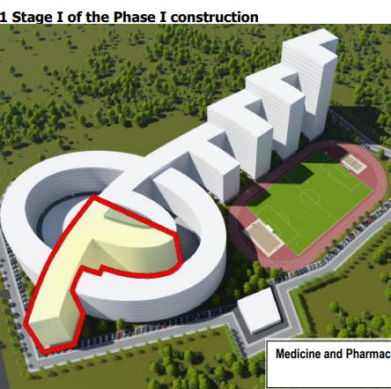
3D Visualization of Boko Campus Under Construction
Highlighted in red: the area of the campus building currently under construction

Slide 17
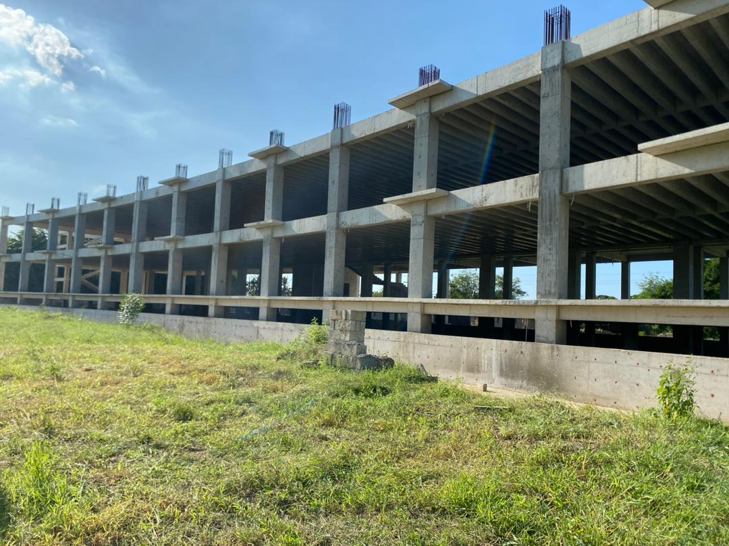
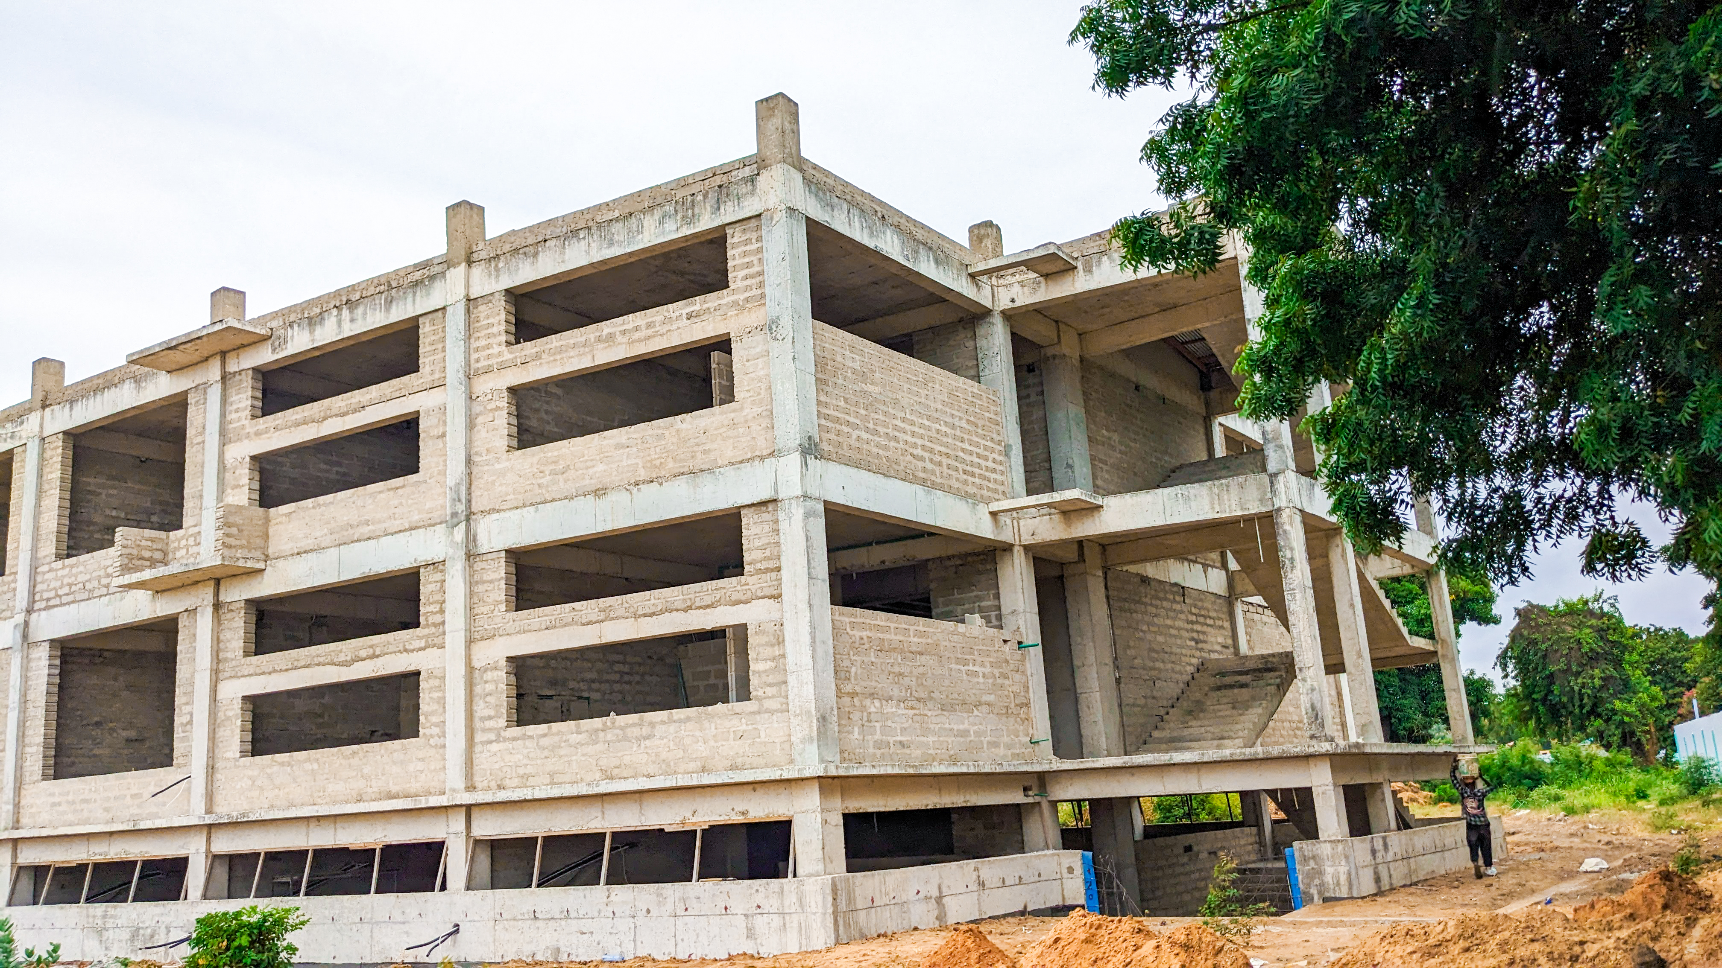
Actual photos showing the building before block walling and after block walling, as illustrated above

Slide 18
Preparation for BRIDGE training Hub
The two dedicated classrooms are situated within a newly constructed academic building currently at the final finishing stage
The classrooms are expected to be fully completed by end of April 2026
Once completed, the facility will provide a conducive smart learning environment suitable for hosting national and international training activities

Slide 19
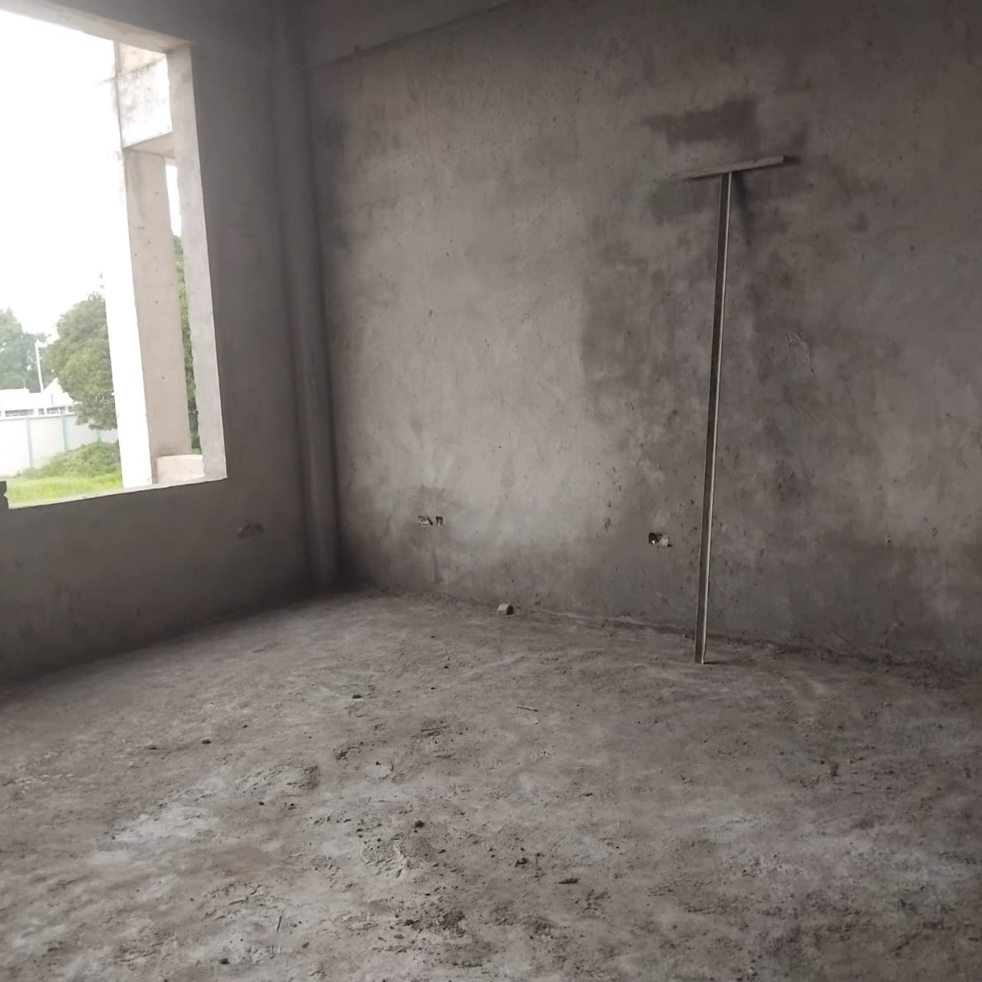
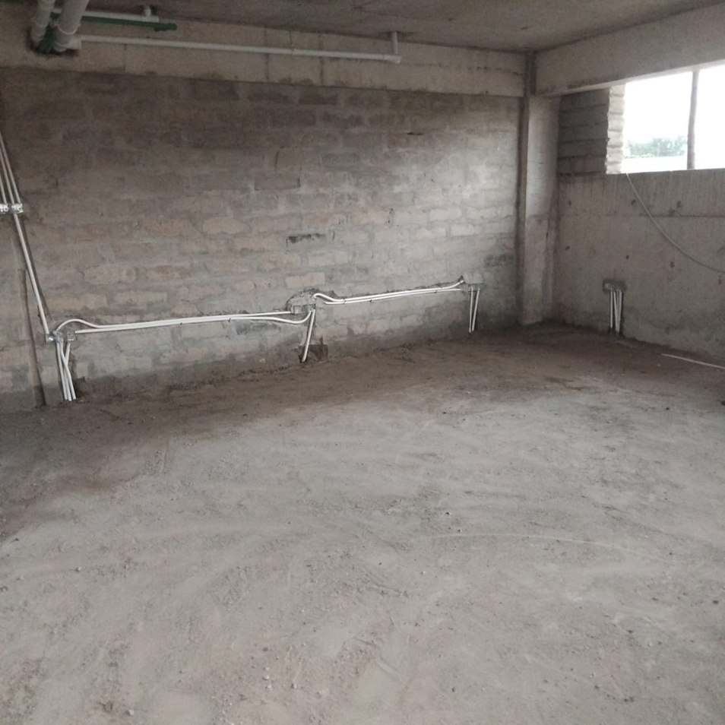
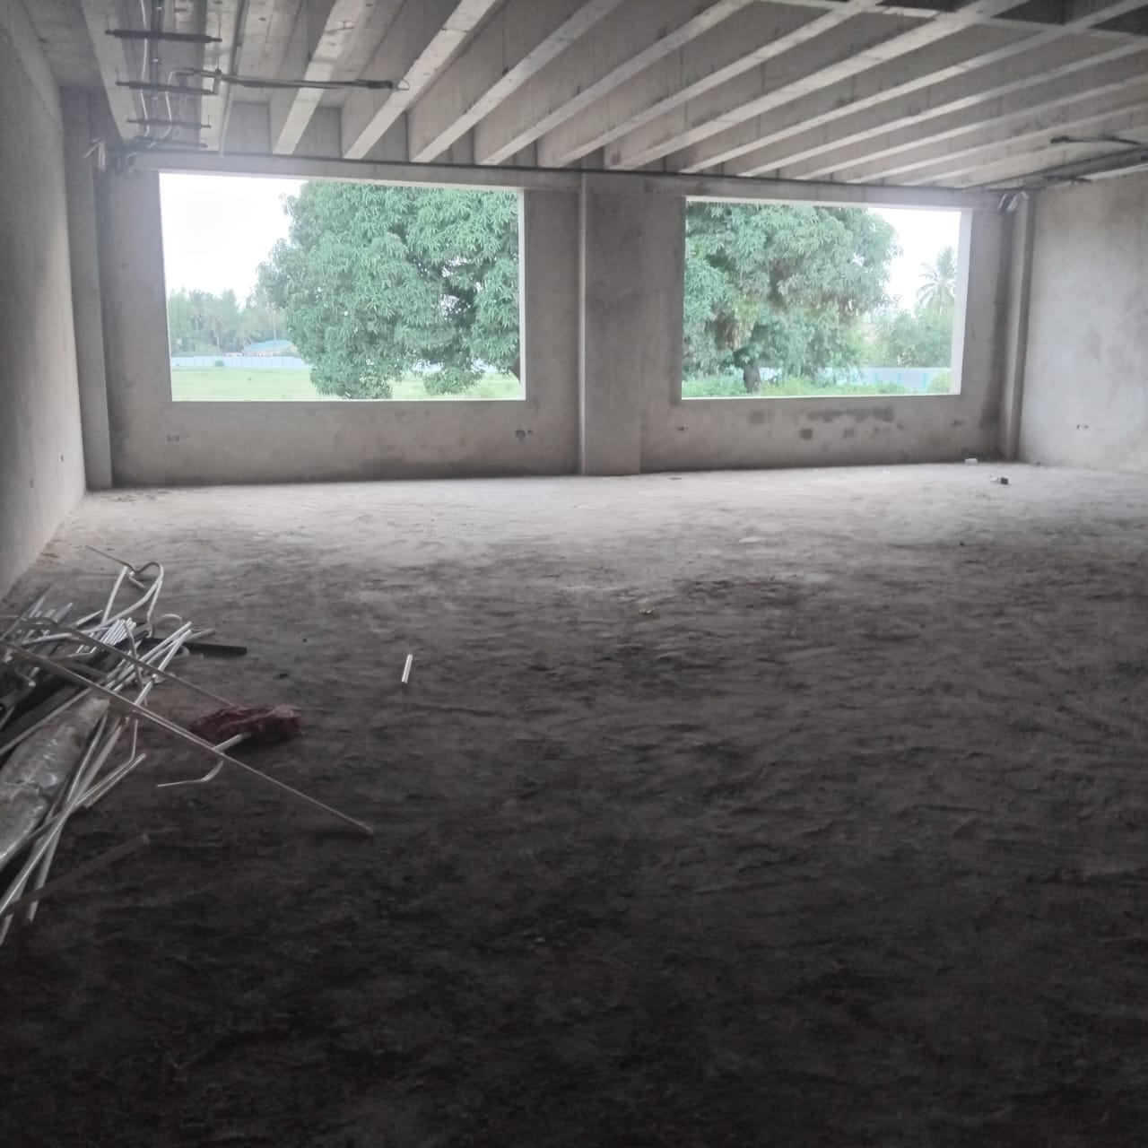
TV Broadcasting Room: Plaster work completed
Area: 30m2
Headroom 3.6m
Seminar Room: 1st fix completed
Area: 65.62
Headroom 2 .9m
Skills Labs-1 : Plaster completed
Area: 167.3
Headroom 3.6m

Slide 20
Partnerships
In this competitive world, KU always seeks to learn from all available best practices
The university has a strong resolve towards interdisciplinary activities, colloquia, and research, aiming at forging new alliances for innovativeness in emerging new sciences
In this BRIDGE project partnership, Kairuki will bring its experience in training, research endeavours, and project management required for the successful implementation of the BRIDGE project

Slide 21

Thank you for listening

